Slide 1
Basic Electronics I
Objectives
Define basic components of electricity
Recognize the 3 electrical classifications of materials
Compare and contrast AC vs. DC
Explain the concept of grounding
Use Ohm’s law and Watt’s law to express the relationship between current, voltage, and resistance

Slide 2
Electricity can be broken down into:
Electric Charge
Voltage
Current
Resistance

Slide 3
Negative & Positive Charges
What do the effects of electricity in TV, radio, a battery, and lightening all have in common?
Basic particles of electric charge with opposite polarities.

Slide 4
Electrons
The smallest amount of electrical charge having the quality called negative polarity.
Electrons orbit the center of atoms.

Slide 5
Protons
The proton is a basic particle with positive polarity.
Protons are located in the nucleus of atoms along with neutrons, particles which have neutral polarity.

Slide 6
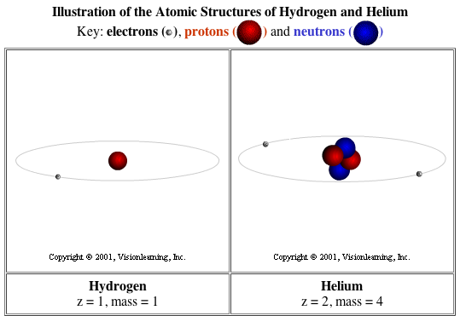

Slide 7
Electrically, all materials fall into 1 of 3 classifications:
Conductors
Insulators
Semi-Conductors

Slide 8
Conductors
Have 1 valence electron
Materials in which electrons can move freely from atom to atom are called conductors.
In general all metals are good conductors.
The purpose of conductors is to allow electrical current to flow with minimum resistance.

Slide 9
Insulators
Have 8 valence electrons
Materials in which electrons tend to stay put and do not flow easily from atom to atom are termed insulators.
Insulators are used to prevent the flow of electricity.
Insulating materials such as glass, rubber, or plastic are also called dielectrics, meaning they can store charges.
Dielectric materials are used in components like capacitors which must store electric charges.

Slide 10
Semi-Conductors
Have 4 valence electrons
Materials which are neither conductors nor insulators
Common semi conductor materials are carbon, germanium and silicone.
Used in components like transistors

Slide 11
The Symbol for Charge
The symbol for charge is Q which stands for quantity.
The practical unit of charge is called the coulomb (C).
One coulomb is equal to the amount of charge of 6.25X10¹⁸ electrons or protons stored in a dielectric.

Slide 12
Voltage
Potential refers to the the possibility of doing work.
Any charge has the potential to do the work of attracting a similar charge or repulsing an opposite charge.
The symbol for potential difference is E (for electromotive force)
The practical unit of potential difference is the volt (V)
1 volt is a measure of the amount of work required to move 1C of charge

Slide 13
Current
When a charge is forced to move because of a potential difference (voltage) current is produced.
In conductors - free electrons can be forced to move with relative ease, since they require little work to be moved.
So current is charge in motion.
The more electrons in motion the greater the current.

Slide 14
Amperes
Current indicates the intensity of the electricity in motion. The symbol for current is I (for intensity) and is measured in amperes.
The definition of current is: I = Q/T
Where I is current in amperes, Q is charge in coulombs, and T is time in seconds.

Slide 15
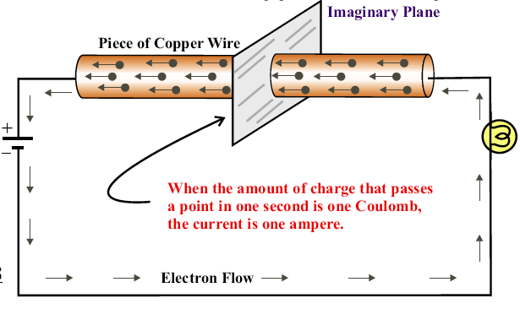
1 ampere = 1 coulomb per second

Slide 16
Resistance
Opposition to the flow of current is termed resistance.
The fact that a wire can become hot from the flow of current is evidence of resistance.
Conductors have very little resistance.
Insulators have large amounts of resistance.

Slide 17
Ohms
The practical unit of resistance is the ohm designated by the Greek letter omega: Ω
A resistor is an electronic component designed specifically to provide resistance.

Slide 18
Closed Circuits
In applications requiring the use of current, electrical components are arranged in the form of a circuit.
A circuit is defined as a path for current flow.

Slide 19
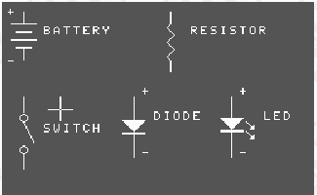
Common Electronic Component Symbols

Slide 20
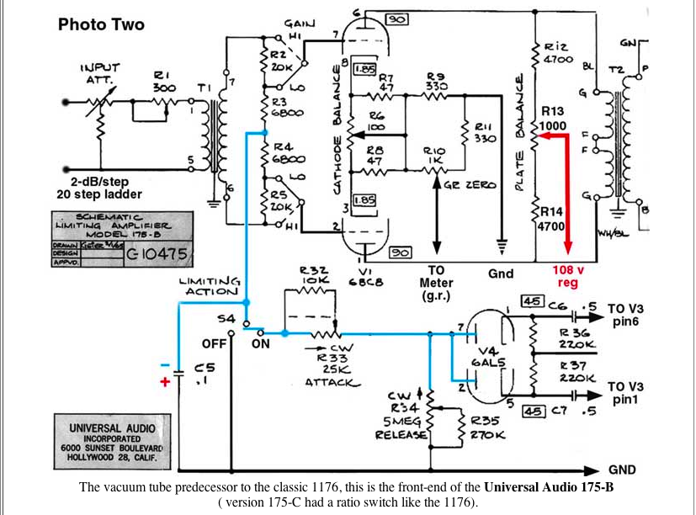
A Complex Audio Circuit

Slide 21
Open Circuits

Slide 22
The Circuit is a Load on the Voltage Source
The circuit is where the energy of the source (battery) is carried by means of the current through the the various components.
The battery is the source, since it provides the potential energy to be used.
The circuit components are the load resistance - they determines how much current the source will produce.

Slide 23
Direction of Electron Flow
The direction of electron flow in our circuit is from the negative side of the battery, through the load resistance, back to the positive side of the battery.
Inside the battery, electrons move to the negative terminal due to chemical action, maintaining the potential across the leads.

Slide 24
Electron Flow in a Simple Circuit

Slide 25
DC
Circuits that are powered by battery sources are termed direct current circuits.
This is because the battery maintains the same polarity of output voltage. The plus and minus sides remain constant.

Slide 26
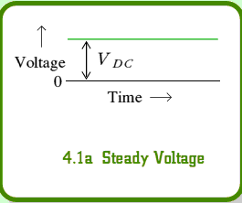
Waveform of DC Voltage

Slide 27
Characteristics of DC
It is the flow of charges in just one direction and...
The fixed polarity of the applied voltage which are characteristics of DC circuits

Slide 28
AC
An alternating voltage source periodically alternates or reverses in polarity.
The resulting current, therefore, periodically reverses in direction.
The power outlet in your home is 60 cycle ac - meaning the voltage polarity and current direction go through 60 cycles of reversal per second.
All audio signals are AC also.

Slide 29
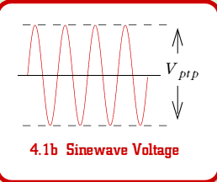
Waveform of AC Voltage

Slide 30
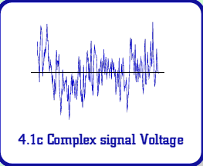
Complex Voltage
This is a more realistic view of what
an audio signal’s voltage would look like

Slide 31
Comparison of DC & AC
DC Voltage | AC Voltage
Fixed polarity | Reverses polarity
Can be steady or vary in magnitude | Varies in magnitude between reversals in polarity
Steady value cannot be stepped up or down by a transformer | Used for electrical power distribution
Electrode voltage for tube and transistor amps | I/O signal for tube and transistor amps
Easier to measure | Easier to amplify
Heating Effects the same for both AC and DC current

Slide 32
Many Circuits Include both AC & DC Voltages
DC circuits are usually simpler than AC circuits.
However, the principles of DC circuits also apply to AC circuits.

Slide 33
Impedance
Impedance is resistance to current flow in AC circuits and its symbol is Ζ.
Impedance is also measured in ohms.

Slide 34
Grounding
In the wiring of practical circuits one side of the voltage source is usually grounded for safety.
For 120 V - ac power lines in homes this means one side of the voltage source is connected to a metal cold water pipe.
For electronic equipment, the ground just indicates a metal chassis, which is used as a common return for connections to the source.

Slide 35
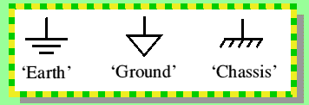
Common Symbols/ Names for Ground in Electric Circuits

Slide 36
Ohm’s Law
The amount of current in a circuit is dependent on its resistance and the applied voltage. Specifically I = E/R
If you know any two of the factors E, I, and R you can calculate the third.
Current I = E/R
Voltage E = IR
Resistance R = E/I

Slide 37
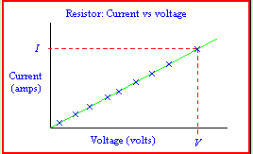
Current is Directly Proportional to Voltage for a Constant Resistance
OHM’s LAW

Slide 38
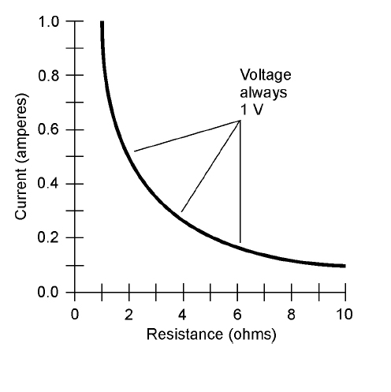
Current is Inversely Proportional to Resistance for a Constant Voltage
OHM’s LAW

Slide 39
Power
The unit of electrical power is the watt.
Power is how much work is done over time.
One watt of power is equal to the work done in one second by one volt moving one coulomb of charge. Since one coulomb a second is an ampere:
Power in watts = volts x amperes
P = E x I

Slide 40
3 Power Formulas
P = E x I
P = I^{2 x} R
P = E² / R

Slide 41
Conversion Factors
Prefix | Symbol | Relation to basic unit | Examples
Mega | M | 1,000,000 or 1x10⁶ | 5MΩ = 5x10⁶ Ω
Kilo | k | 1,000 or 1x10³ | 18kV = 18x10³ V
Milli | m | .001 or 1x10⁻³ | 48 mA = 48x10⁻³A
Micro | μ | .000001 or 1x10⁻⁶ | 15μV = 15x10⁻⁶V

